Slide 1
COMPUTER ORGANIZATION AND ARCHITECTURE
Dr. Rizwan Khan
Head – Department of Computer Science and Engineering
(An NBA Accredited Program)
ABES Institute of Technology, Ghaziabad

Slide 2
Making Larger Memories
Using the CS lines, we can make larger memories from smaller ones by tying all address, data, and R/W lines in parallel, and using the decoded higher order address bits to control CS.
Using the 4-Word by 1-Bit memory from before, we construct a 16-Word by 1-Bit memory. ⇒

Slide 3
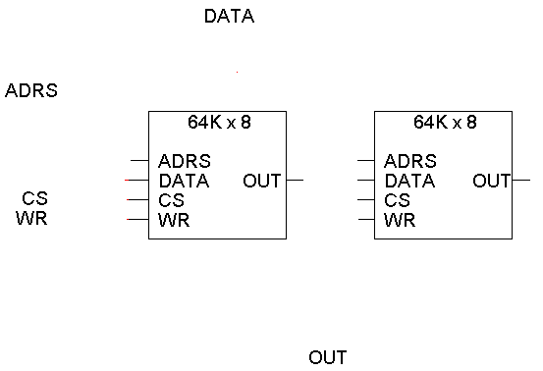
Making a wider memory
You can also combine smaller chips to make wider memories, with the same number of addresses but more bits per word.
How do we create a 64K x 16 RAM from two 64K x 8 chips?

Slide 4
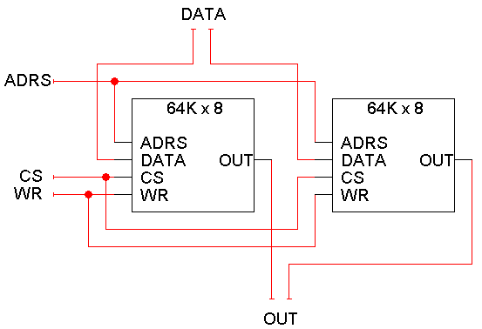
Making a wider memory
You can also combine smaller chips to make wider memories, with the same number of addresses but more bits per word.
Here is a 64K x 16 RAM, created from two 64K x 8 chips.
The left chip contains the most significant 8 bits of the data.
The right chip contains the lower 8 bits of the data.
8
8
16
8
8

Slide 5
Making Wider Memories
To construct wider memories from narrow ones, we tie the address and control lines in parallel and keep the data lines separate.
For example, to make a 4-word by 4-bit memory from 4, 4-word by 1-bit memories ⇒
Note: Both 16x1 and 4x4 memories take 4-chips and hold 16 bits of data.

Slide 6


